Slide 1
Climate Refugees
Alert Ahead & Proactive Prepeartion

Slide 2
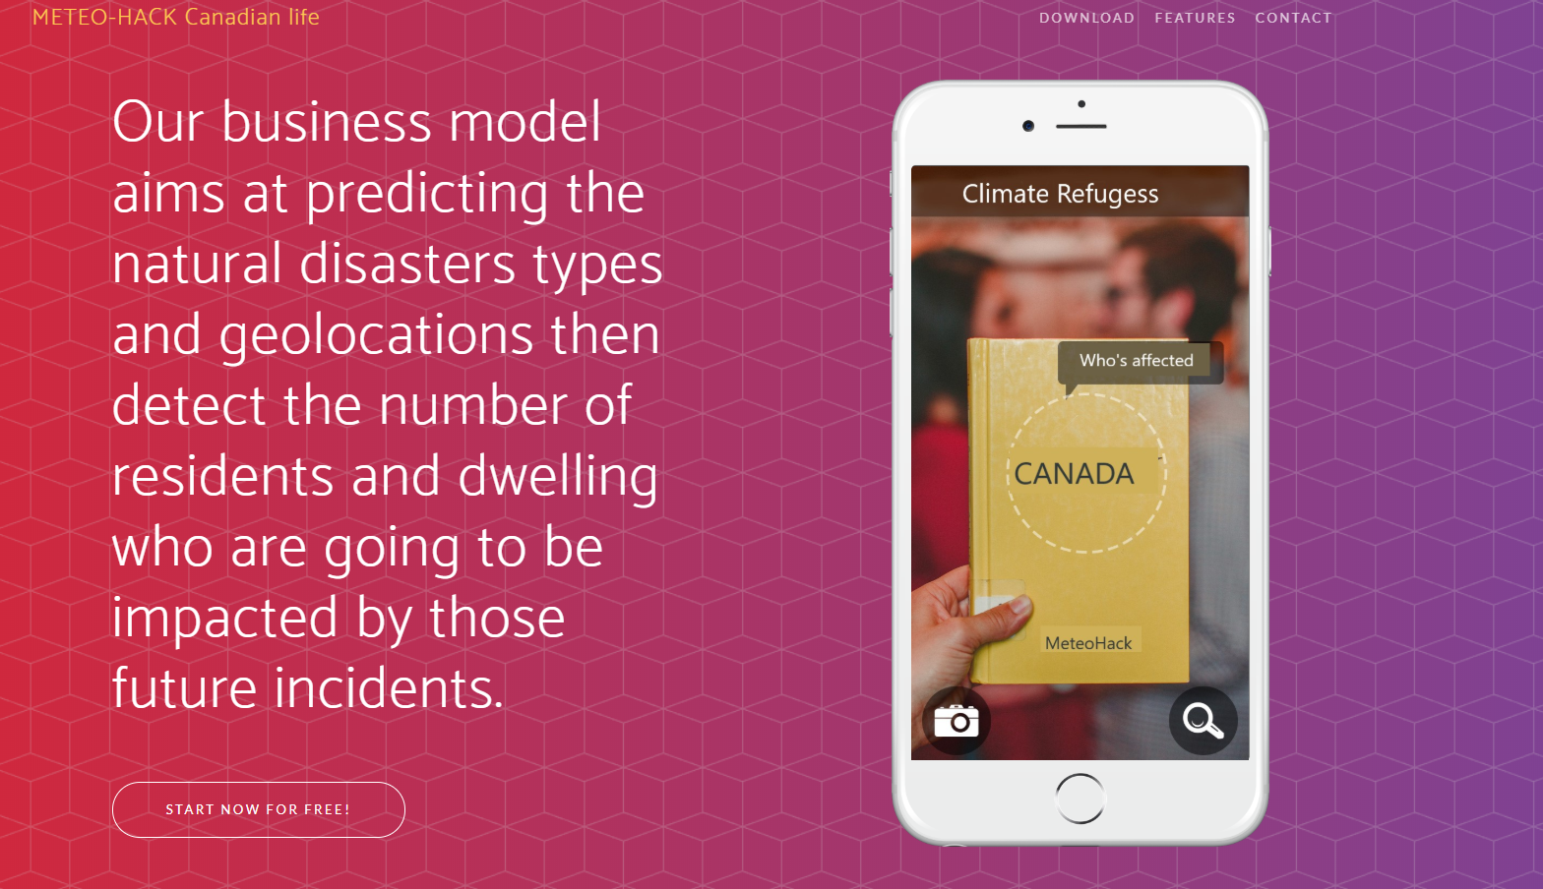

Slide 3
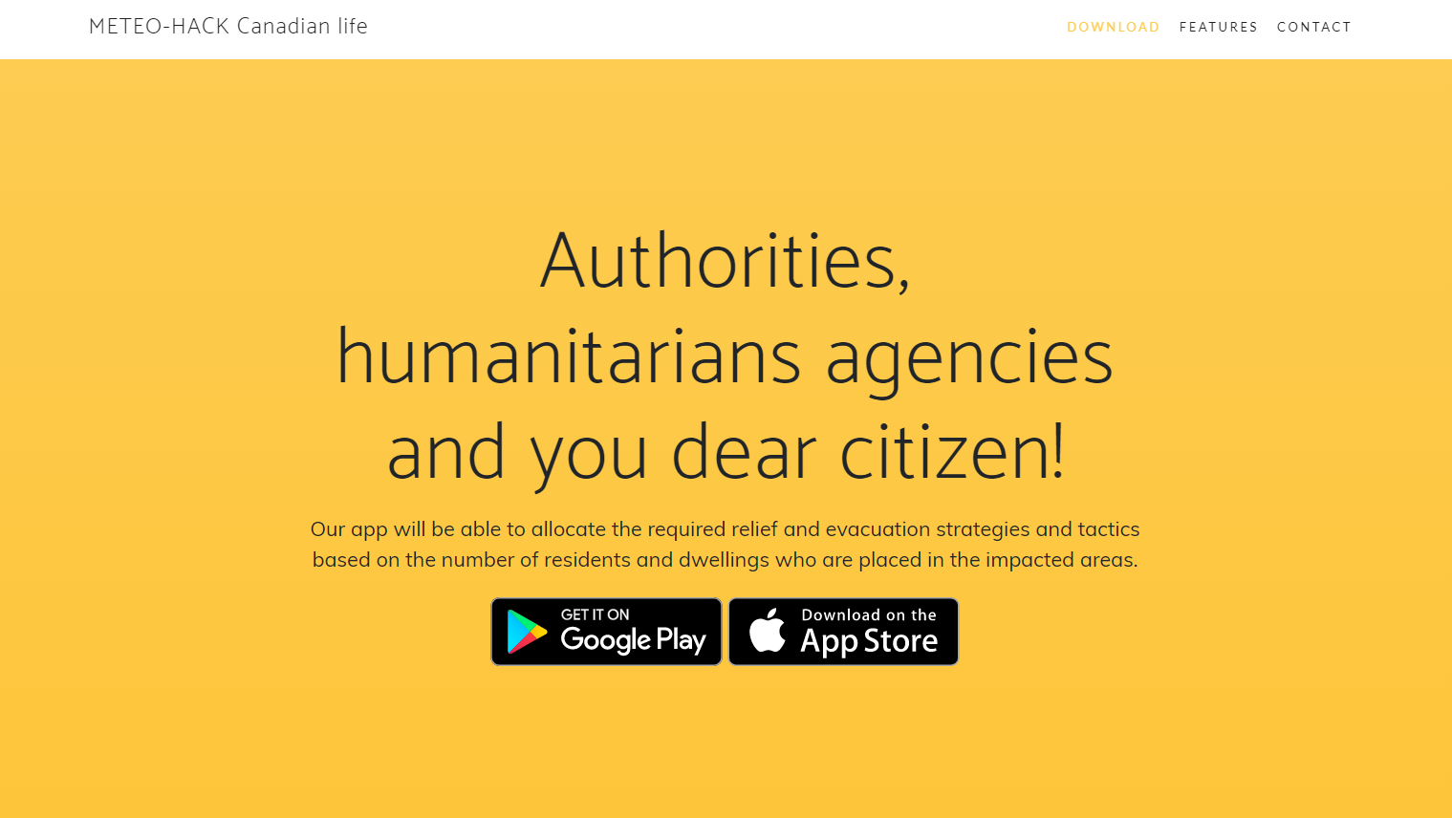

Slide 4
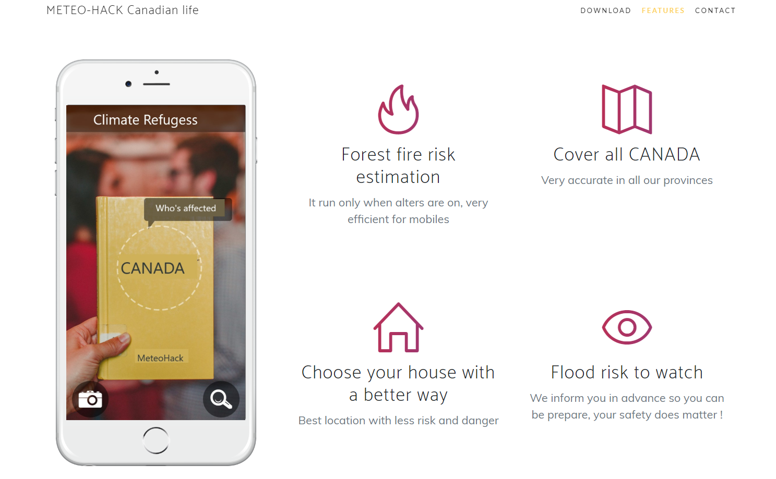

Slide 5
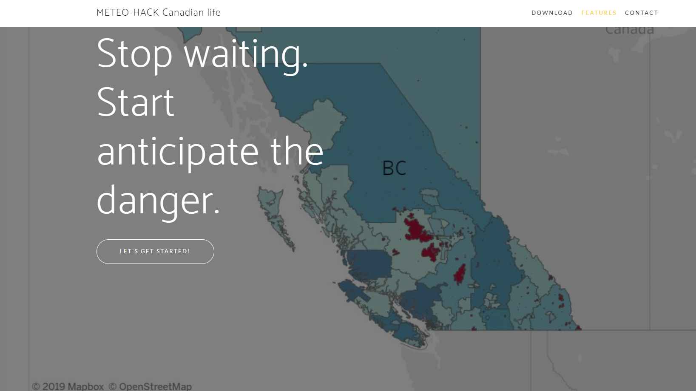

Slide 6
Flood Data
https://open.canada.ca/data/en/dataset/b1afd8d2-6e14-4ec4-9a09-652221a6cb71
https://webservices.maps.canada.ca/arcgis/rest/services/NRCan/EGS_Flood_Product_CurrentYear_en/MapServer/1
Fire Data
http://cwfis.cfs.nrcan.gc.ca/datamart/download/nfdbpoly?token=5839494ebfe00fd18ee7dd2ad9dfa8f3
2016 Census Data
https://www12.statcan.gc.ca/census-recensement/2016/dp-pd/hlt-fst/pd-pl/Table.cfm?Lang=Eng&T=1201&S=22&O=A

